Slide 1



University Institute of Engineering
DEPARTMENT OF COMPUTER SCIENCE & ENGINEERING
Subject Name: Software Engineering
Subject Code: 23CST-206
Er. Jagmeet Kaur
E8387
ASSISTANT PROFESSOR
CSE
DISCOVER . LEARN . EMPOWER

Slide 2
Topics covered
Behavior Diagrams
Use case Diagrams

Slide 3
Behavior Diagrams
Sequence Diagram
A sequence diagram simply depicts interaction between objects in a sequential order i.e. the order in which these interactions take place.
We can also use the terms event diagrams or event scenarios to refer to a sequence diagram.
Sequence diagrams describe how and in what order the objects in a system function.
These diagrams are widely used by businessmen and software developers to document and understand requirements for new and existing systems.

Slide 4
Behavior Diagrams
Sequence Diagram
Sequence diagram describes an interaction by focusing on the sequence of messages that are exchanged, along with their corresponding occurrence specifications on the lifelines.
Sequence diagram is used to:
Represent the details of a UML use case.
Model the logic of a sophisticated procedure, function, or operation.
See how objects and components interact with each other to complete a process.
Plan and understand the detailed functionality of an existing or future scenario.

Slide 5
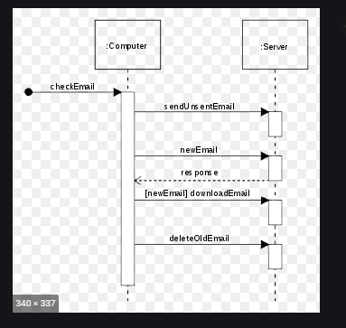
Sequence Diagram

Slide 6
Behavior Diagrams
Communication Diagram
A Communication Diagram(known as Collaboration Diagram in UML 1.x) is used to show sequenced messages exchanged between objects.
A communication diagram focuses primarily on objects and their relationships.
We can represent similar information using Sequence diagrams, however, communication diagrams represent objects and links in a free form.

Slide 7
Behavior Diagrams
Communication Diagram
Communication diagrams offer benefits similar to sequence diagrams, but they will offer a better understanding of how components communicate and interact with each other rather than solely emphasizing the sequence of events.
They can be a useful reference for businesses, organizations, and engineers who need to visualize and understand the physical communications within a program.

Slide 8
Behavior Diagrams
Communication Diagram
Model the logic of a sophisticated procedure, function, or operation.
Identify how commands are sent and received between objects or components of a process.
Visualize the consequences of specific interactions between various components in a process.
Plan and understand the detailed functionality of an existing or future scenario.

Slide 9
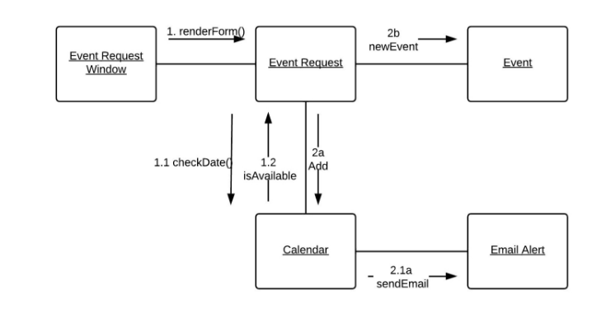
Communication Diagram

Slide 10
Behavior Diagrams
Timing Diagram
Timing Diagram are a special form of Sequence diagrams which are used to depict the behavior of objects over a time frame.
We use them to show time and duration constraints which govern changes in states and behavior of objects.
Timing diagrams are UML interaction diagrams used to show interactions when a primary purpose of the diagram is to reason about time. Timing diagrams focus on conditions changing within and among lifelines along a linear time axis. Timing diagrams describe behavior of both individual classifiers and interactions of classifiers, focusing attention on time of events causing changes in the modeled conditions.

Slide 11
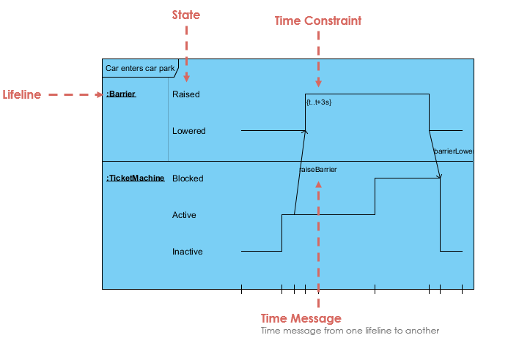
Behavior Diagrams
Timing Diagram

Slide 12
Behavior Diagrams
Use Case Diagrams
Use Case Diagrams are used to depict the functionality of a system or a part of a system.
They are widely used to illustrate the functional requirements of the system and its interaction with external agents(actors).
A use case is basically a diagram representing different scenarios where the system can be used.

Slide 13
Use Case Diagrams
The purposes of use case diagrams can be said to be as follows
Used to gather the requirements of a system.
Used to get an outside view of a system.
Identify the external and internal factors influencing the system.
Show the interaction among the requirements are actors.

Slide 14
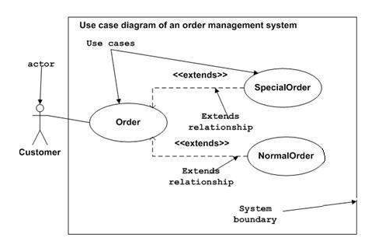
Use Case Diagrams

Slide 15
Use Case Diagrams
Use case diagrams can be used for −
Requirement analysis and high level design.
Model the context of a system.
Reverse engineering.
Forward engineering.

Slide 16
REFERENCES
Reference Books:
Suman Ugrasen, “Software Engineering - Concepts and Practices”, First Edition, Cengage.
Mohammad Ali Shaikh, “Software Engineering with UML”, Third Edition, Notion Press.
Somerville Ian, “Software Engineering”, Addison Wesley, 8th Edition.
Text Books:
Pressman Rogers, “Software Engineering: A Practitioner's Approach”, Sixth edition. Patterson and Hennessy, “Computer Architecture” , Fifth Edition Morgaon Kauffman.
Rajib Mall, “Fundamentals of Software Engineering’’, Fourth Edition, Pearson, PHI.
Image Reference
https://www.uml.org/
https://www.geeksforgeeks.org/unified-modeling-language-uml-introduction/

Slide 17
THANK YOU

